Slide 1
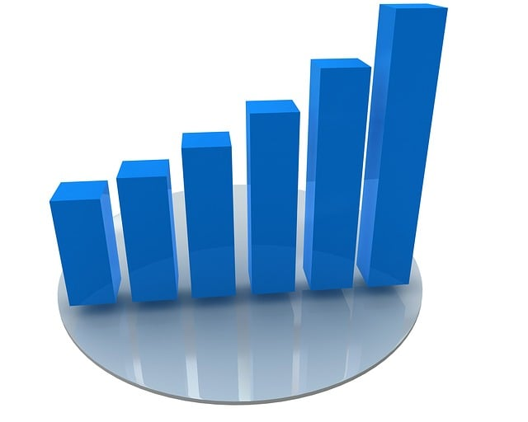
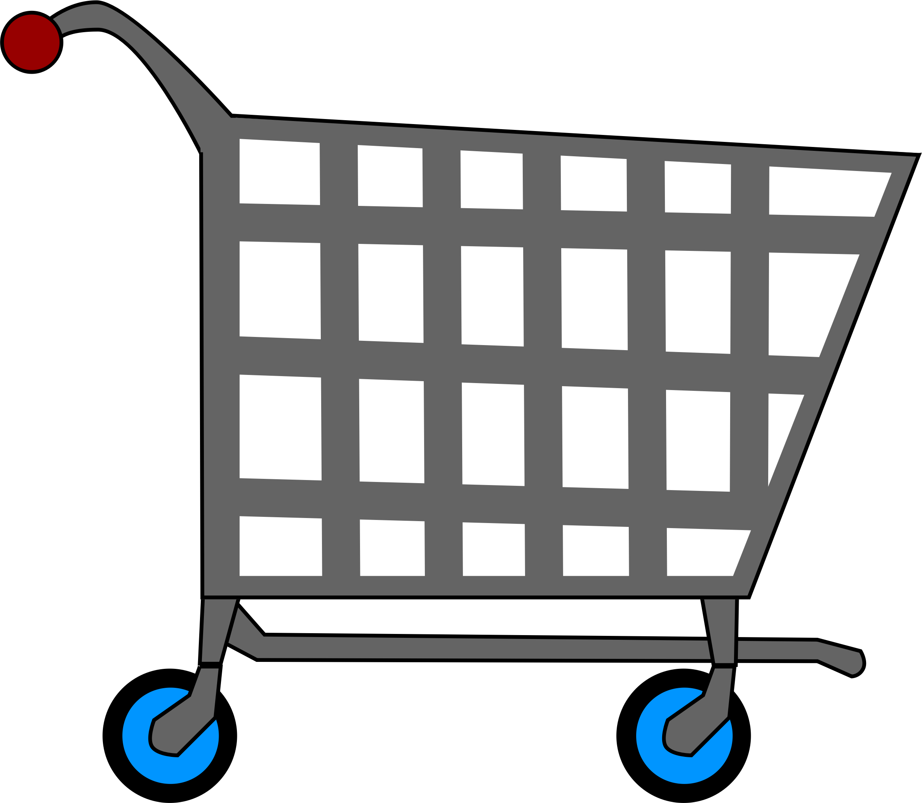

Data Visualization Dashboard for Consumer Behavior Analysis
“Unveiling Consumer Insights Through Data and Machine Learning”
Team Members:
Vishesh Bharuka
Kishan Kumar Parida
Sujan DM

Slide 2
Introduction
“Exploring consumer behavior insights through data-driven analysis and visualization."
Data Analysis: Examined spending patterns, customer demographics, and behavioral trends.
Machine Learning: Leveraged clustering, anomaly detection, and personalized recommendations.
Interactive Dashboard: Designed in Power BI to transform insights into actionable visuals.

Slide 3
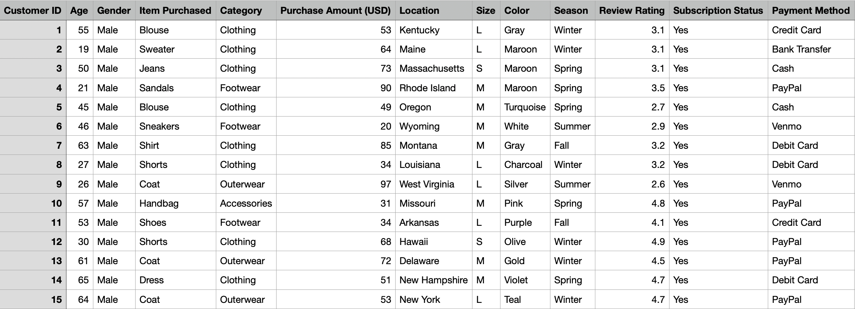
Dataset overview
Source : Consumer Behaviour Dataset
Size: 3,900 customer transactions with 19 features.
Key Details:
Demographics: Age, Gender, Location.
Purchase Data: Items, Categories, Purchase Amounts.
Insights :Review Ratings, Purchase Frequency, Previous Transactions.
Preferences: Payment Methods, Discounts, Promo Code Usage.
Purpose: Analyze patterns and trends to discover actionable consumer insights.
Preprocessing steps:
Missing values: Minimal and addressed by imputation or removal.
Duplicates: Removed to ensure data integrity.
Standardized column names for uniformity.

Slide 4
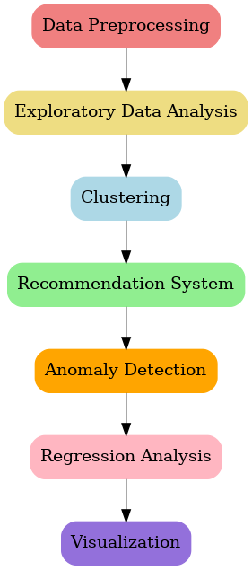
WORKFLOW
Data Preprocessing: Cleaned and prepared data for analysis.
Exploratory Data Analysis (EDA): Visualized trends and patterns.
Clustering: Segmented customers using K-Means.
Recommendation System: Built collaborative filtering model for personalized suggestions.
Anomaly Detection: Flagged unusual transactions using Isolation Forest.
Regression Analysis: Predicted purchase amounts with Random Forest.
Visualization: Developed comprehensive charts for insights.

Slide 5
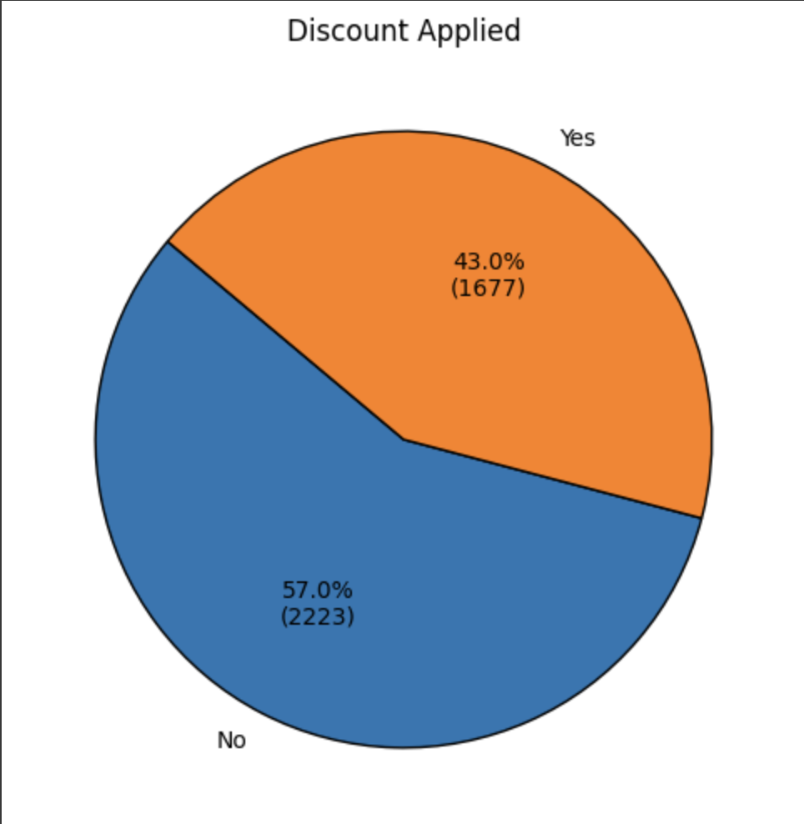
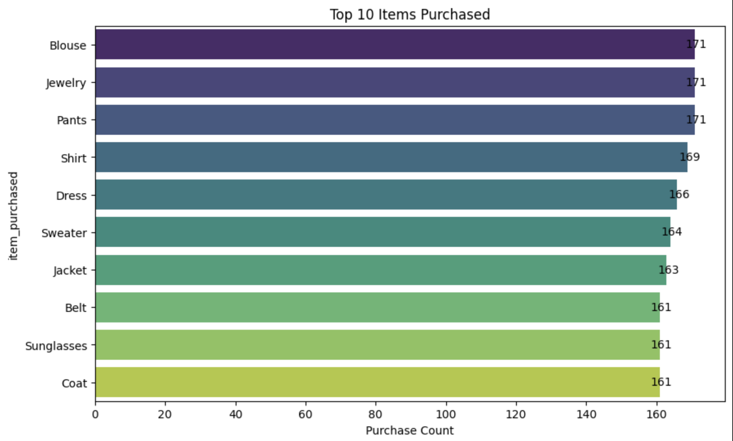
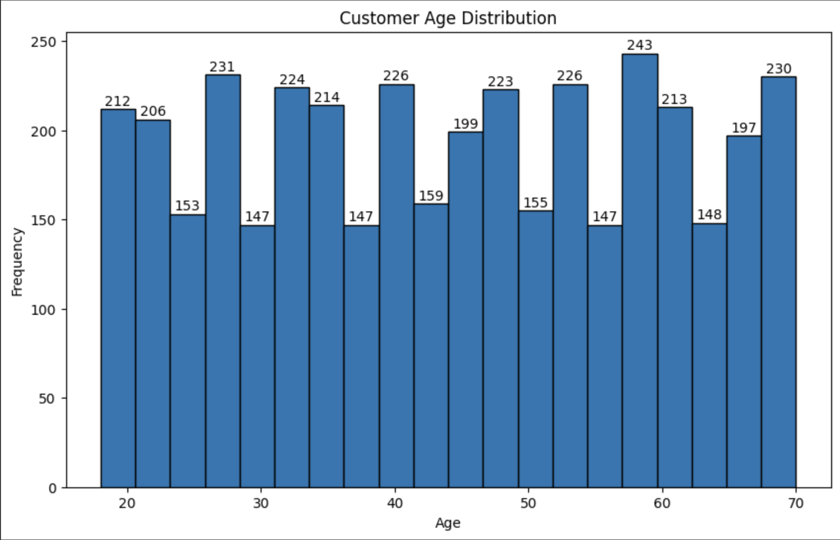
EXPLORATORY DATA ANALYSIS
Key Insights:
Age Distribution: Majority of customers fall in the 25–49 age range.
Top Products: Clothing and accessories are the most purchased categories.
Spending Patterns: Average purchase amount: $59.76. Categories like "Clothing" see higher spending.
Review Ratings: Average rating: 3.75.
Discount Influence: 43% of purchases involved discounts, showing their significance.

Slide 6
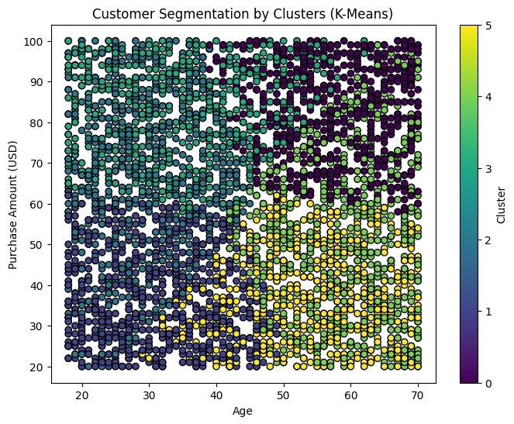
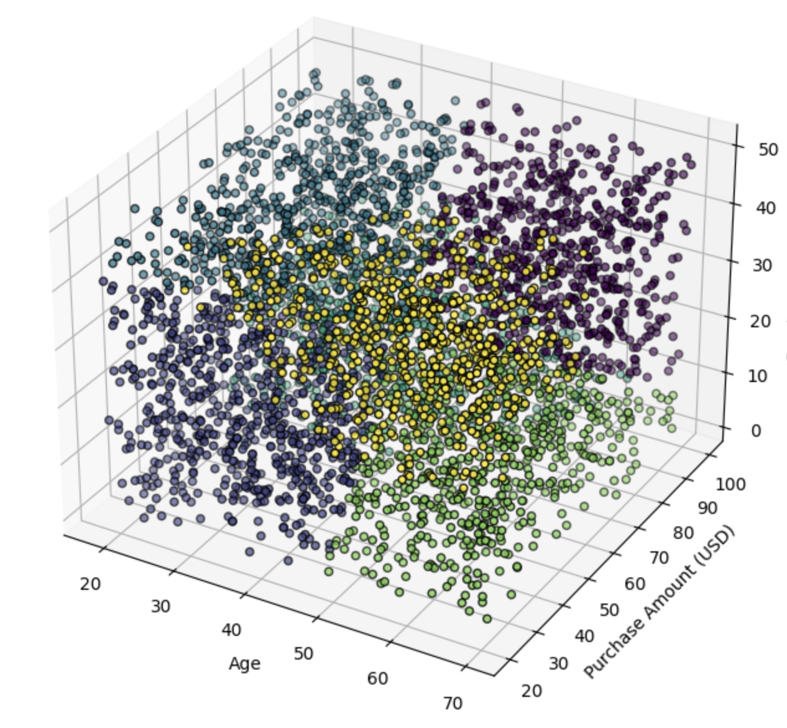
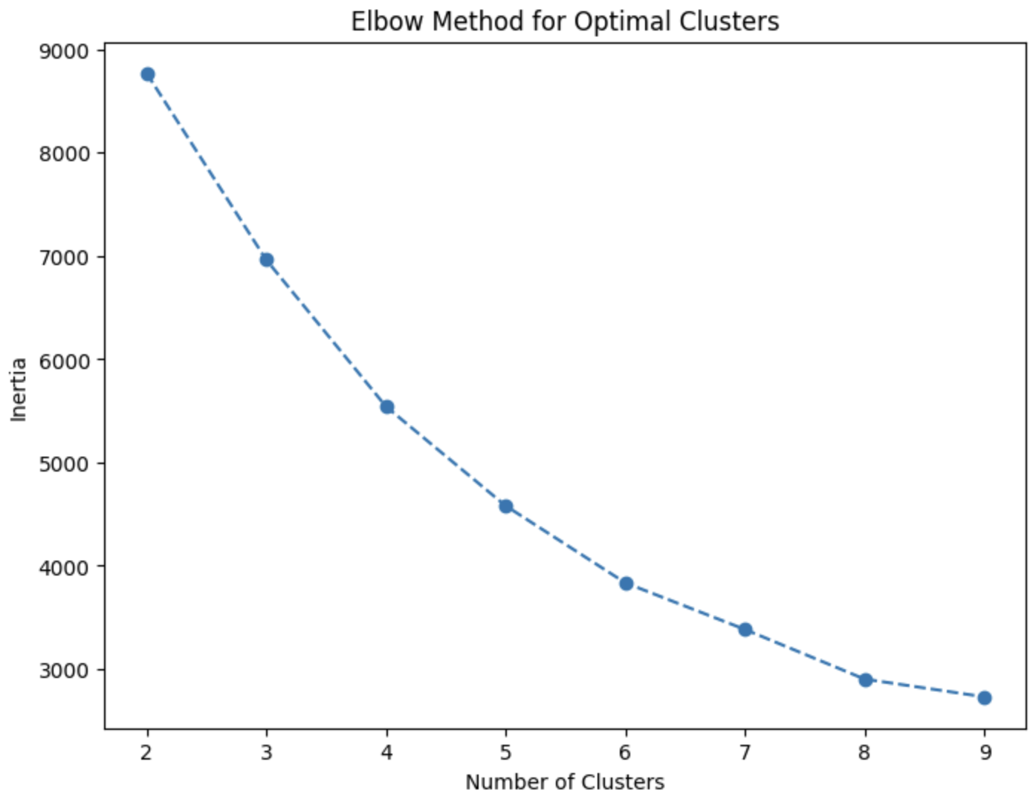
CUSTOMER SEGMENTATION WITH K-MEANS
Our objective was to segment customers based on age, purchase amount and previous purchases.
Insights:
Cluster 1: Young customers with low spending and minimal purchase history.
Cluster 2: Middle-aged customers with moderate spending and occasional purchases.
Cluster 3: High-spending frequent buyers, predominantly older customers.
Cluster 4: Customers with low purchase amounts but a consistent history of purchases.
Cluster 5: Irregular buyers with varied spending habits, typically younger to middle-aged.
Cluster 6: Loyal customers with a balanced mix of moderate spending and consistent purchase history.
Strategic Recommendations:
Target high spenders by offering exclusive deals and recommendations.
Engage low spenders by using discounts and rewards to encourage higher spending.
Nurture Loyal Customers with loyalty programs.

Slide 7
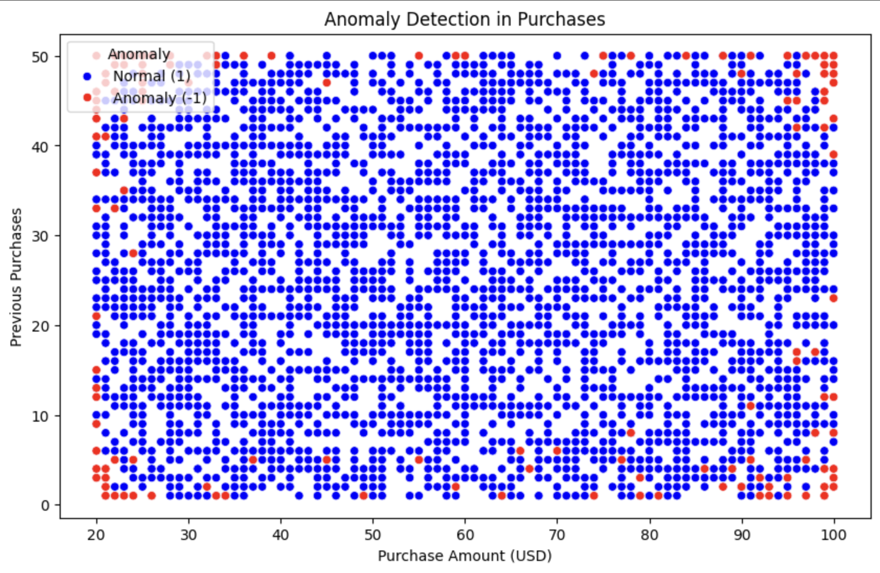
ANAMOLY DETECTION WITH ISOLATION FOREST
Our objective was to identify unusual purchase behavior to detect outliers in customer transactions by applying isolation forest algorithm.
Insights:
195 out of 3900 transactions were flagged as outliers
Examples for outliers include customers with extremely high spending or low review ratings compared to their purchase history.
Applications:
To detect fraudulent activities.
To understand unusual customer segments .

Slide 8
Recommendation system
Aim is to provide personalized product recommendations to enhance customer experience by using LightFM Algorithm with collaborative filtering and content-based filtering.
Features incorporated:
User attributes: Customer ID, Gender.
Item Attributes: Item Purchased, Season
Recommendations given are tailored to customer preferences based on past purchases and product features.
Example: For customer 2499, top recommendations includes- pants, shoes, sunglasses, jewelry, shirt.
Applications:
Enhanced Customer Experience: Deliver personalized shopping suggestions to boost engagement and satisfaction.
Increased Sales: Suggest complementary or frequently bought items to drive upselling and cross-selling.
Retention Strategies: Use recommendations to retain customers by offering relevant products aligned with their preferences.

Slide 9
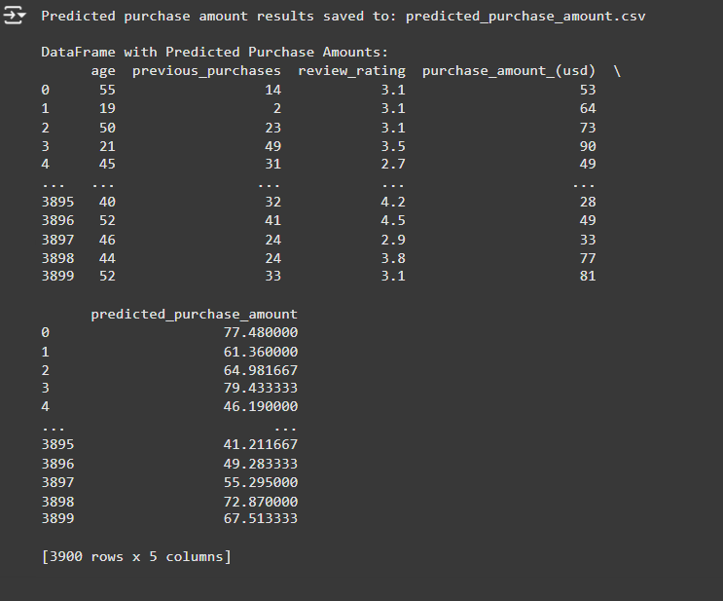
PREDICTING PURCHASE AMOUNTS USING REGRESSION ANALYSIS
Objective is to forecast spending to identify potential high-value customers by implementing a random forest regressor to predict purchase amounts.
Predicted purchase amounts closely align with actual spending patterns.
Example: Customers with higher review ratings and frequent purchases tend to have higher predicted spending.

Slide 10
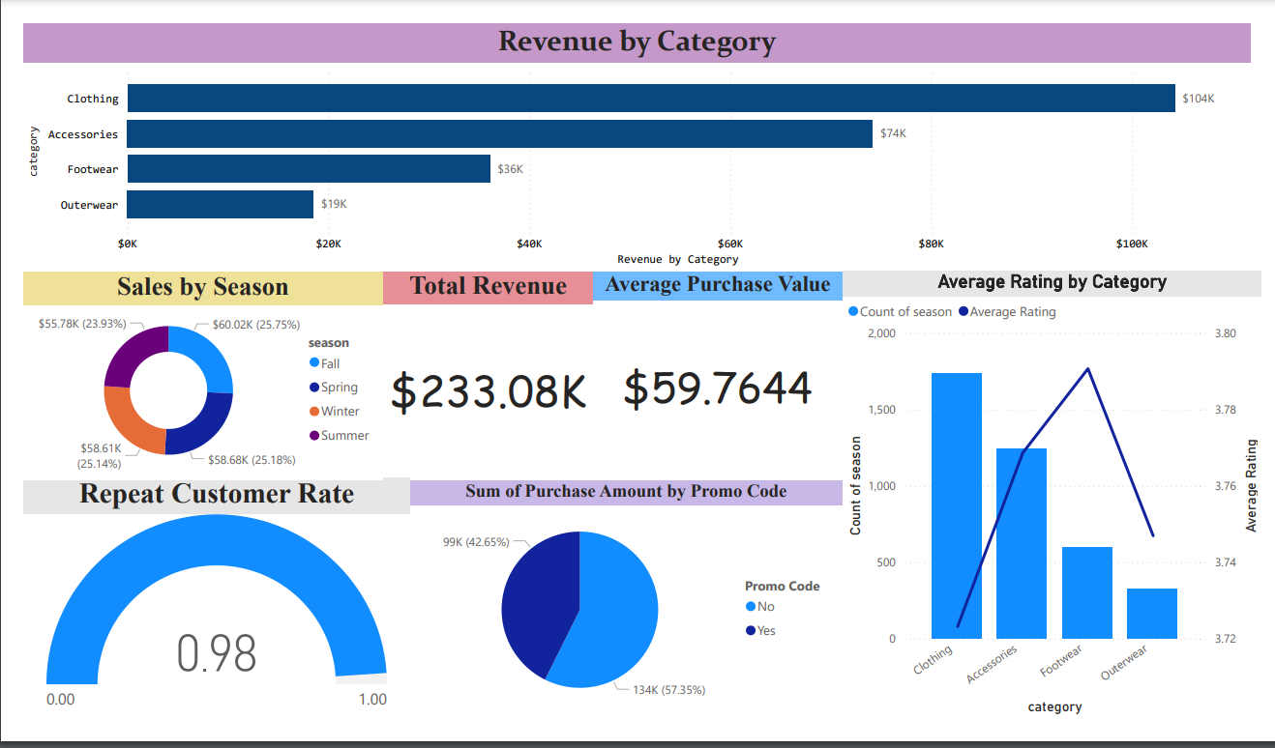
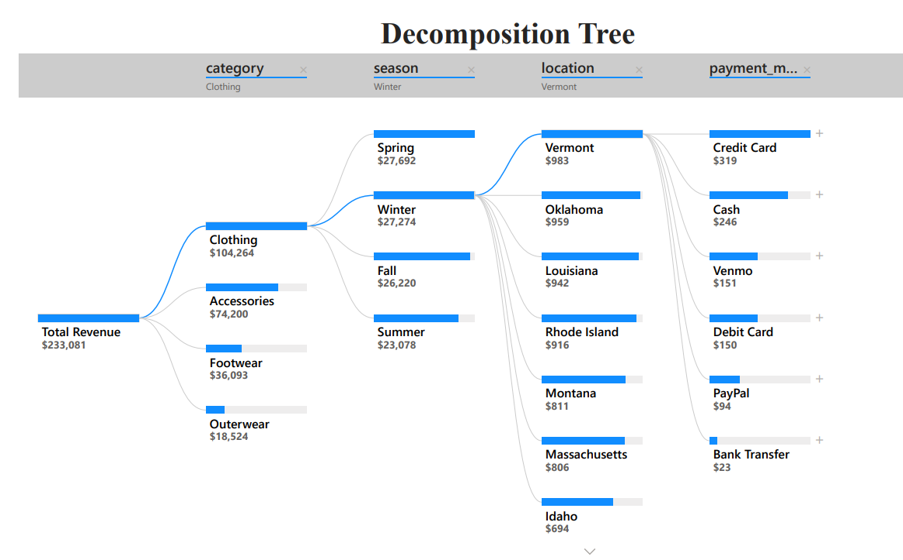
POWER BI DASHBOARD
To create an interactive dashboard that visualizes consumer behavior metrics and uncovers actionable insights for informed decision-making.
Features:
Revenue Analysis: Displays total revenue, average purchase value, and category-wise sales performance.
Seasonal Trends: Highlights sales distribution across seasons to identify peak shopping periods.
Customer Engagement: Tracks metrics like repeat customer rates and promo code usage to understand buying pattern.
Geographical Insights: Provides a breakdown of revenue by region to pinpoint top-performing locations.
Payment Preferences: Visualizes customer choices for payment methods, helping optimize transaction processes.

Slide 11
RESULTS AND ACHIEVEMENTS
Comprehensive Consumer Insights: Identified key trends in spending, demographics, and purchasing habits using data visualization and analysis.
Effective Customer Segmentation: Clustered customers into six distinct groups to enable targeted marketing and personalized strategies.
Anomaly Detection Success: Flagged 5% of transactions as anomalies, uncovering potential fraud and unique behavior patterns.
Personalized Recommendations: Built a recommendation system that effectively suggests relevant products, improving customer satisfaction.
Accurate Predictions: Developed a purchase amount prediction model with actionable insights into customer spending potential.
Interactive Dashboard: Designed a Power BI dashboard to present data-driven insights in a user-friendly and actionable format.
Business Value: Insights and models empower better decision-making, optimize marketing efforts, and enhance customer engagement strategies.

Slide 12
CONCLUSION
This project provided valuable insights into consumer behavior through data exploration, machine learning and visualization.
Actionable Insights: Identified key trends, customer segments, and patterns to drive better marketing and operational strategies.
Business Impact: Enhanced decision-making with tools like the Power BI dashboard, predictive models, and recommendations
Future Scope: Expanding the analysis with additional datasets or advanced models to refine strategies and insights further.

